Slide 1
Machine Learning Supervised Learning Preliminaries for a Predictive Model
Instructor: Zainab Yousuf

Slide 2
Content
Introduction to probability as a building block of Bayesian Classifier
Probability theory
Random Experiment
Sample Space
Events
Types of Events
Independent Events VS Dependent Events
Probability of events
Probability of Dependent & Independent Events
Conditional Probability

Slide 3

Probability theory
Randomness is all around us.
Probability theory is the mathematical framework that allows us to analyse chance events in a logically sound manner.
The probability of an event is a number indicating how likely that event will occur.
This number is always between 0 and 1, where 0 indicates impossibility and 1 indicates certainty.

Slide 4

Random Experiment
A random experiment is a physical situation whose outcome cannot be predicted until it is observed.
Before rolling a die you do not know the result. This is an example of a random experiment.
A classic example of a probabilistic experiment is a fair coin toss, in which the two possible outcomes are heads or tails. In this case, the probability of flipping a head or a tail is ½ that is 50%.
In particular, a random experiment is a process by which we observe something uncertain.
After the experiment, the result of the random experiment is known.

Slide 5

Sample Space
An outcome is a result of a random experiment and the set of all possible outcomes is called the sample space.
Thus in the context of a random experiment, the sample space is our universal set.
Here are some examples of random experiments and their sample spaces:
Random experiment#1: toss a coin; sample space: S={heads, tails} or as we usually write it as {H,T}
Random experiment #2: roll a die; sample space: S={1,2,3,4,5,6}
Random experiment #3: observe the number of iPhones sold by an Apple store in Boston in 2015; sample space: S={0,1,2,3,⋯}
Random experiment #4: observe the number of goals in a soccer match; sample space: S={0,1,2,3,⋯}
We toss a coin three times and observe the sequence of heads/tails. The sample space here may be defined as:
S={(H,H,H),(H,H,T),(H,T,H),(T,H,H),(H,T,T),(T,H,T),(T,T,H),(T,T,T)}.

Slide 6

Events
An event (E) is a subset of the sample space.
For example, The sample space for the tossing of three coins simultaneously is given by:
S = {(T , T , T) , (T , T , H) , (T , H , T) , (T , H , H ) , (H , T , T ) , (H , T , H) , (H , H, T) ,(H , H , H)}
Suppose, if we want to find only the outcomes which have at least two heads; then the set of all such possibilities can be given as:
E = { (H , T , H) , (H , H ,T) , (H , H ,H) , (T , H , H)}

Slide 7
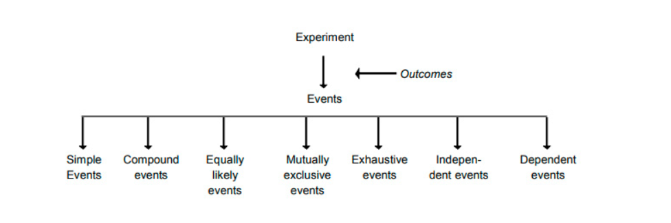
Types of Events
From the above types of events we will be discussing the following:
Independent Events
Dependent Events

Slide 8
Independent Events VS Dependent Events
If the occurrence of any event is completely unaffected by the occurrence of any other event, such events are known as an independent event in probability and the events which are affected by other events are known as dependent events.
Example of independent event, (coin again!) if you toss a coin twice, then the result of the second throw is not affected by the result of the first throw.
Example of dependent event, (No coin this time) Let’s say that the event is drawing a Queen from a pack of 52 cards. When you start with a new deck of cards, the probability of drawing a Queen is 4/52. However, if you manage to draw a Queen in one trial and do not replace the card in the pack, then the probability of drawing a Queen in the remaining trials becomes 3/51.

Slide 9

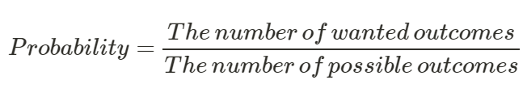
Probability of events
Probability is a type of ratio where we compare how many times an outcome can occur compared to all possible outcomes.
Probability is the measure of the likelihood that an event will occur in a Random Experiment.
Example: What is the probability to get a 6 when you roll a die? A die has 6 sides, 1 side contain the number 6 that give us 1 wanted outcome in 6 possible outcomes so it becomes 1/6

Slide 10
Probability of Dependent & Independent Events
Two events are independent when the outcome of the first event does not influence the outcome of the second event. And when we determine the probability of two independent events we multiply the probability of the first event by the probability of the second event.
P(XandY)=P(X)⋅P(Y) or P(X∩Y)=P(X).P(Y)
Two events are dependent when the outcome of the first event influences the outcome of the second event. The probability of two dependent events is the product of the probability of X and the probability of Y AFTER X occurs which is called as conditional probability.
P(XandY)=P(X)⋅P(Y After X) or P(X∩Y)=P(X).P(Y|X)

Slide 11
Probability of Dependent & Independent Events
Example of Independent Events: If one has three dice what is the probability of getting three 4s?
The probability of getting a 4 on one dice is 1/6 (for each dice)
The probability of getting 3 4s is:
P(4and4and4)=1/6⋅1/6⋅1/6=1/216
Example of dependent Events: What is the probability for you to choose two red cards in a deck of cards? (A deck of cards has 26 black and 26 red cards)
The probability of choosing a red card randomly is: (for first time)
P(A)=P(red)=26/52=1/2
The probability of choosing a second red card from the deck is now: (since the first red card is withdrawn)
P(B/A)=P(red)=25/51
The probability of 2 red cards is:
P(A and B)=P(A)*P(B/A)=1/2⋅25/51=25/102

Slide 12
Conditional Probability
The conditional probability of an event B is the probability that the event will occur given the knowledge that an event A has already occurred. This probability is written P(B|A), notation for the probability of B given A.
In the case where events A and B are independent (where event A has no effect on the probability of event B), the conditional probability of event B given event A is simply the probability of event B, that is P(B).
If events A and B are not independent, then the probability of the intersection of A and B (the probability that both events occur) is defined by P(A ∩ B) = P(A)P(B|A)
From this definition, the conditional probability P(B|A) is easily obtained by dividing P(A and B) by P(A)

Slide 13

Conditional Probability
Conditional Probability is a measure of the probability of an event given that (by assumption, presumption, assertion or evidence) another event has already occurred.
If the event of interest is A and the event B is known or assumed to have occurred, “the conditional probability of A given B”, is usually written as P(A|B).
Example: Event A is that it is raining outside, and it has a 0.3 (30%) chance of raining today and Event B is that you will need to go outside, and that has a probability of 0.5 (50%).
P(A|B) = (0.3*0.5)/0.3 = 50%

Slide 14
Conditional Probability
Example: In a group of 100 sports car buyers, 40 bought alarm systems, 30 purchased bucket seats, and 20 purchased an alarm system and bucket seats. If a car buyer chosen at random bought an alarm system, what is the probability they also bought bucket seats?
Step 1: Figure out P(A). It’s given in the question as 40%, or 0.4.
Step 2: Figure out P(A∩B). This is the intersection of A and B: both happening together. It’s given in the question 20 out of 100 buyers, or 0.2.
Step 3: Insert your answers into the formula: P(B|A) = P(A∩B) / P(A) = 0.2 / 0.4 = 0.5.
The probability that a buyer bought bucket seats, given that they purchased an alarm system, is 50%.

Slide 15
Thank You

